Slide 1



Construyendo el futuro de la conectividad, virtudes de GPON.
Victor Manuel Martinez Cano
Product and Engineering Manager of C-Data México
Shenzhen C-Data Technology Co., Ltd.

Slide 2
Syllabus
1 C-Data
2 GPON
3 Línea de soluciones

Slide 3

Acerca de Nosotros

Slide 4

Cobertura en mas de 50 países

Slide 5
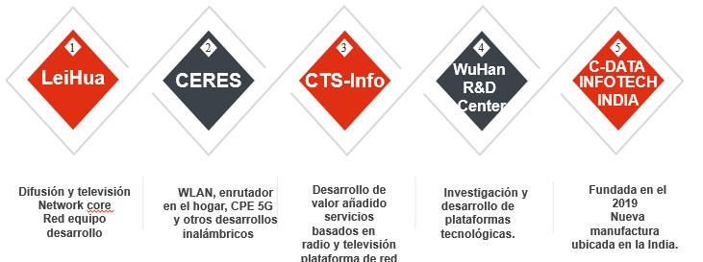
Subsidiarias

Slide 6

Certificaciones
CCC / ANATEL / ISO 9001 / ISO 14001 / FCC

Slide 7
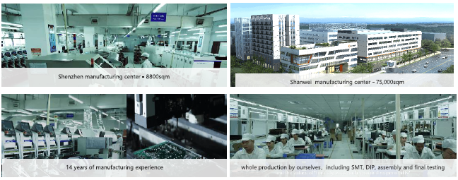




Centro de Manufactura

Slide 8

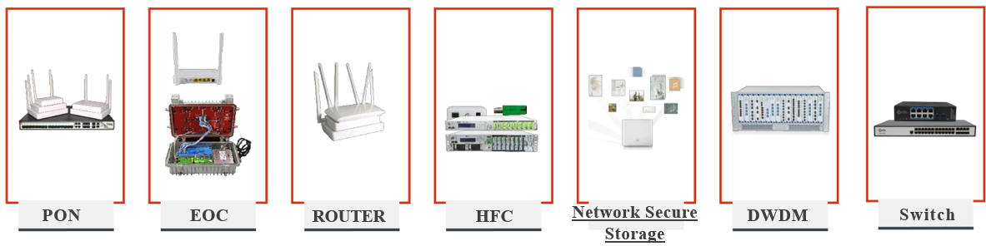
Contamos con 4 escenarios y 7 líneas de solución
FTTx Access
Enterprise/Industry
Home Network
Cable Network

Slide 9
Syllabus
1 C-Data
2 GPON
3 Línea de soluciones

Slide 10
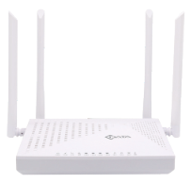

¿Qué es PON?
Passive Optical Network.
Es una red de Fibra Óptica que emplea una topología de punto a multipunto.
VLAN 3
VoIP
TV
Internet
VLAN 1 VLAN 2 VLAN 3
VLAN 1 VLAN 2 VLAN 3
VLAN 1 VLAN 2 VLAN 3
VLAN 1 VLAN 2
Utiliza componentes pasivos y se describe de diferente manera según donde termine la red PON.

Slide 11
Principales ventajas
Entre sus principales ventajas cabe destacar:
◎ Mayor ancho de banda.
◎ Mayor distancia: La fibra óptica permite distancias de cable de hasta 20Km.
◎ Calidad de servicio: GPON garantiza el ancho de banda necesario para cada servicio y usuario.
◎ Seguridad: La información en la fibra óptica viaja cifrada, lo que la garantiza la seguridad en las comunicaciones.
◎ Operatividad: GPON cuenta con un modelo de gestión integrado que simplifica la administración de los equipos.
◎ Escalabilidad: Podemos evolucionar a XG-PON y seguir utilizando la misma infraestructura de fibra.

Slide 12
GPON actualmente
Tiene diferentes aplicaciones:
Transmisión y comunicación mediante Telefonía IP para empresas y particulares, servicio que ofrecen los Operadores de Telecomunicaciones.
Cableado de todo tipo de Edificios, Urbanizaciones y Hoteles.
Es la tecnología más importante y demandada en el sector hotelero (FTTR, fibra hasta la habitación).
Se está convirtiendo en la estructura de telecomunicaciones propia de la Industria 4.0.
Specifications | GPON | 10G GPON
 |  | XG-PON | XGS-PON
Center wavelength | Downstream: 1490 nm Upstream: 1310 nm | Downstream: 1577 nm Upstream: 1270 nm | Downstream: 1577 nm Upstream: 1270 nm
Max. Line Rate | Downstream: 2.488 Gbit/s Upstream: 1.244 Gbit/s | Downstream: 9.953 Gbit/s Upstream: 2.488 Gbit/s | Downstream: 9.953 Gbit/s Upstream: 9.953 Gbit/s
Frame Structure | GEM | XGEM | XGEM
Max. Split Ratio | 1:128 | 1:256 | 1:256

Slide 13
Topología de un red PON

Slide 14
Fiber To The Home
Elementos y aplicaciones de una red FTTH

Slide 15
Fiber To The Home + Wi-Fi Mesh
Se utilizan enrutadores compatibles con Wi-Fi Mesh para mejorar la cobertura.

Slide 16
Syllabus
1 C-Data
2 GPON
3 Line of solutions

Slide 17
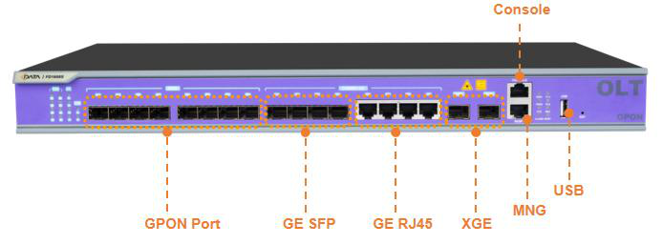
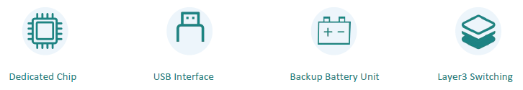
OLT FD1608S-B1
8PON PORTS XPON OLT
USB Port: 1 USB (backup configuration, upgrade, log information)
Port rate: Downstream: 2.5Gbps Upstream: 1.25Gbps
Max splitting: 1:128
Wavelength: 1490nm Receiving: 1310nm
Interface: type SC/UPC
Network management: CLI、SNMP、TELNET、SSH、WEB, OMCI
Combo port: 4 10/100/1000M auto-negotiation Ethernet ports
4 SFP interfaces
2 SFP+ interfaces 10-Gigabit
Layer 2: Switching, VLAN, QoS, Rate limit, ACL
Layer 3: static routing, dhcp-relay and vlanif.

Slide 18
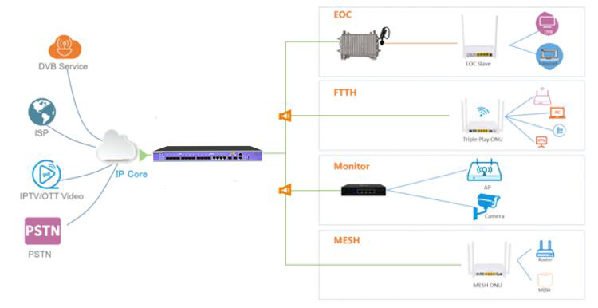
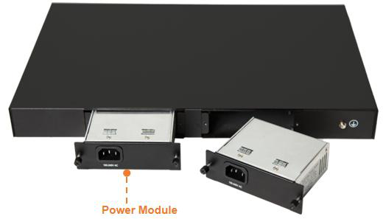
OLT B0 Back view
8PON PORTS XPON OLT
AC: 100V～240V，47/63Hz
DC:-40V～-72V
78W

Slide 19
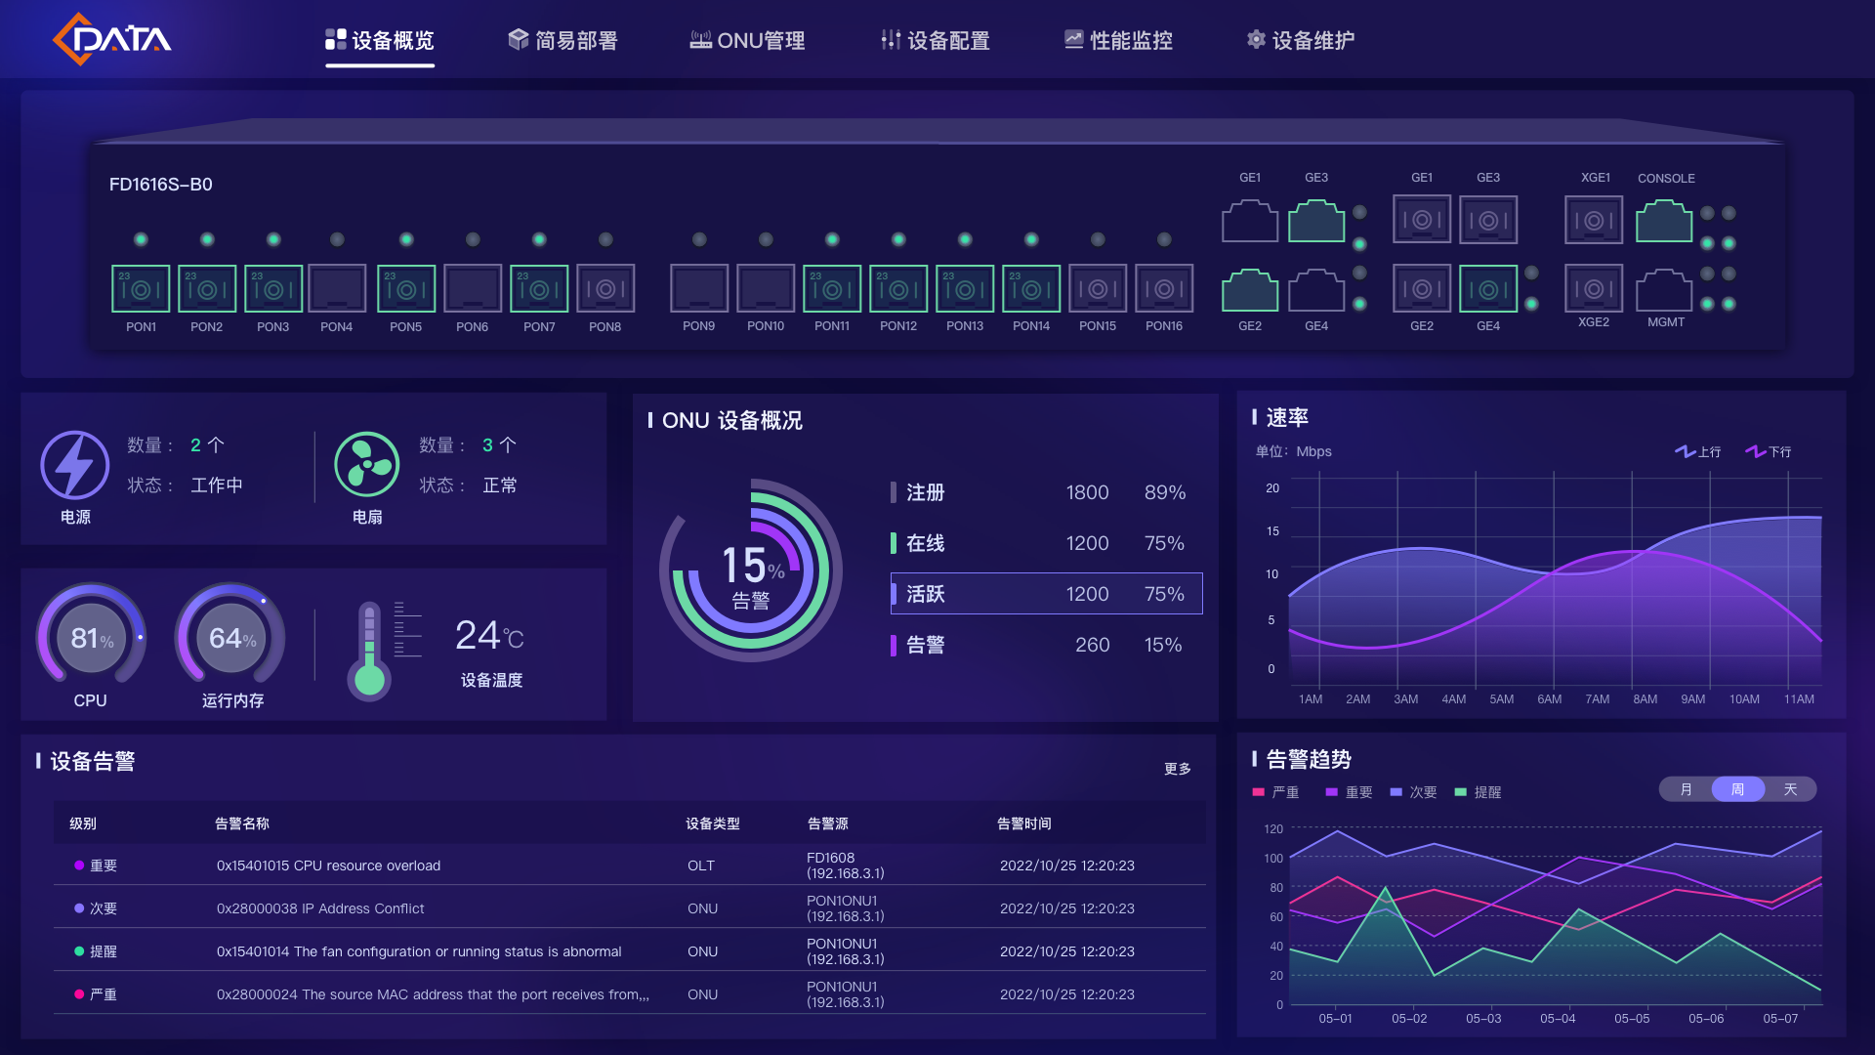
OLT B0 Back view
V3 Version OLT WEB

Slide 20
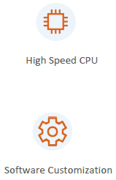
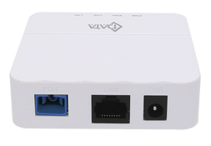
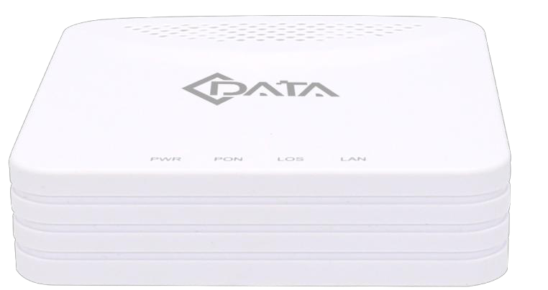

ONU Bridge
FD511G-X
GPON/EPON Port
➢ Single mode single fiber
➢ GPON：2.488Gbps/1.244Gbps downstream/upstream
➢ EPON：1.25Gbps downstream/upstream
➢ Wavelength : Transmit: 1310nm Receiver: 1490nm
Power
➢ External 12VDC/0.5A
➢ Power consumption: <3W
Switch
➢ MAC address learning
➢ MAC address learning
➢ Port isolation
➢ Port flow control
➢ Broadcast
➢ VLAN transparent/tag/trunk
L3
➢IPv4/IPv6 Dual Stack
➢ NAT
➢ DHCP client/server
➢ PPPOE client/ Pass through
➢ Static and dynamic routing
Management
➢ EPON :OAM / WEB / TR069 / Telnet
➢ GPON:OMCI / WEB / TR069 / Telnet
1GE+XPON

Slide 21
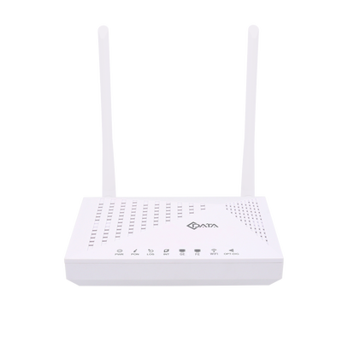
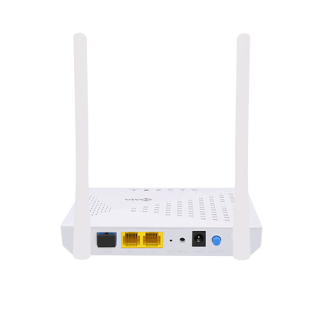
ONU Single Band
FD512XW-X
GPON/EPON Port
➢ Single mode single fiber
➢ GPON：2.488Gbps/1.244Gbps downstream/upstream
➢ EPON：1.25Gbps downstream/upstream
➢ Wavelength : Transmit: 1310nm Receiver: 1490nm
Power
➢ External 12VDC/0.5A
➢ Power consumption: <4W
➢ Support DHCP/Static/PPPOE internet mode
➢ Support port-binding
➢ Support remote OAM/OMCI management
➢ Support Dynamic Bandwidth Allocation (DBA)
➢ EMS network management based on SNMP
WIFI performance parameters
➢ Max rate: 300M(2.4G)
➢ EEE802.11b/g/n(2.4G)
L3
➢IPv4/IPv6 Dual Stack
➢ NAT
➢ DHCP client/server
➢ PPPOE client/ Pass through
➢ Static and dynamic routing
Management
➢ EPON :OAM / WEB / TR069 / Telnet
➢ GPON:OMCI / WEB / TR069 / Telnet
1GE+1FE+1WIFI XPON

Slide 22
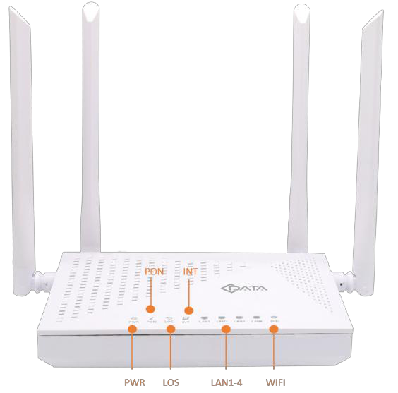
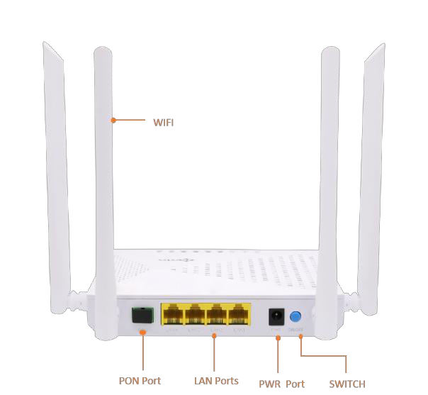
ONU Dual Band
FD504GW-DX-R461
GPON/EPON Port
➢ GPON：2.488Gbps/1.244Gbps downstream/upstream
➢ EPON：1.25Gbps downstream/upstream
➢ Wavelength : Transmit: 1310nm Receiver: 1490nm
Power
➢ External 12VDC/1A
➢ Support DHCP/Static/PPPOE internet mode
➢ Support port-binding
➢ Support remote management configuration
➢ Support Dynamic Bandwidth Allocation (DBA)
➢ EMS based on SNMP
WIFI performance parameters
➢ Max rate: 300M(2.4G)
➢ Max rate: 867Mbps(5G)
4GE+2WIFI XPON

Slide 23
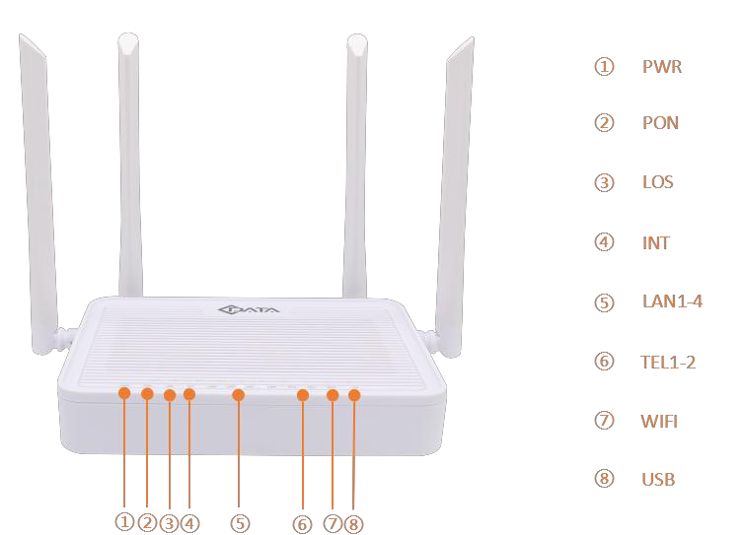
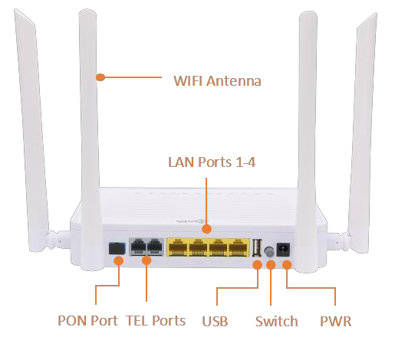
ONU Wi-Fi 6
FD604GW-SX-R770
GPON/EPON Port
➢ GPON：2.488Gbps/1.244Gbps downstream/upstream
➢ EPON：1.25Gbps downstream/upstream
➢ Wavelength : Transmit: 1310nm Receiver: 1490nm
Power
➢ External 12VDC/1.5A
WIFI performance parameters
➢ IEEE802.11b/g/n/ax(2.4G) – 600 Mbps
➢ IEEE802.11a/n/ac/ax(5G) – 1201 Mbps
Management
➢ EPON :OAM / WEB / TR069 / Telnet
➢ GPON :OMCI / WEB / TR069 / Telnet
Multicast
➢ IGMP V2 / VLAN / Snooping
Security
➢ Firewall / MAC Address / Remote WEB
➢ 2*2 MIMO
4GE+2POTS+2WIFI6 XPON ONU

Slide 24
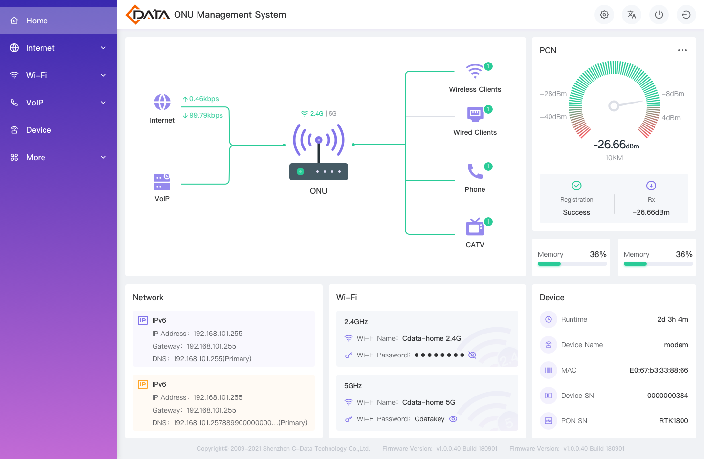
ONU Wi-Fi 6
ONU WEB V3

Slide 25
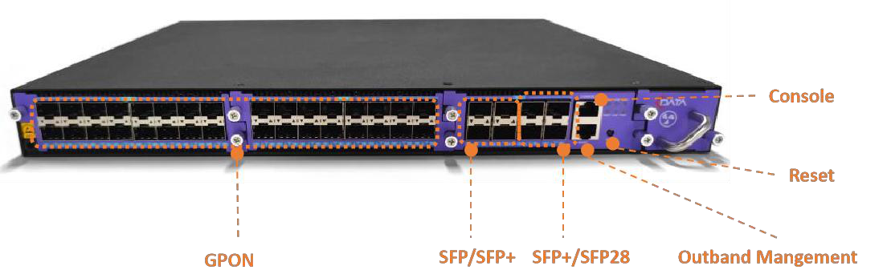
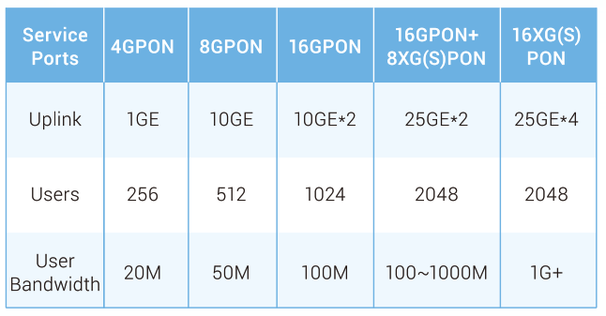
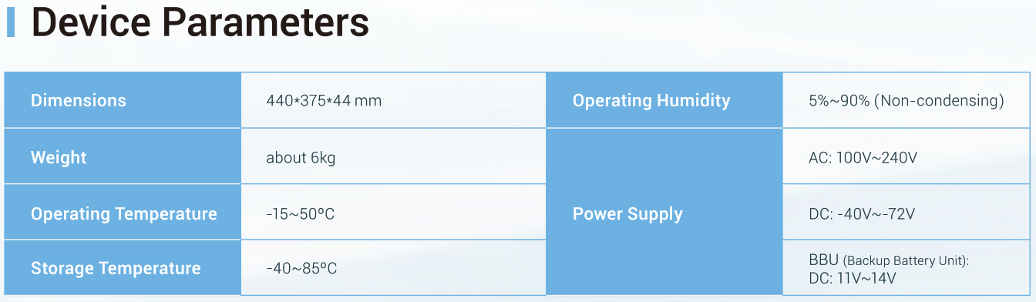
OLT - FD1700S 32 PON Ports

Slide 26
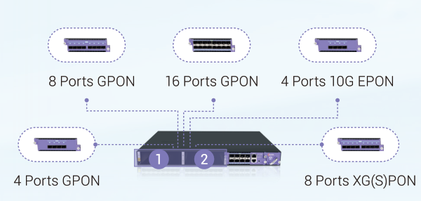
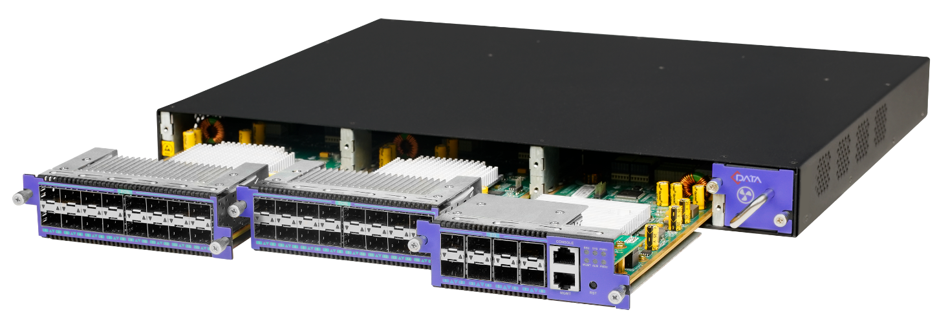
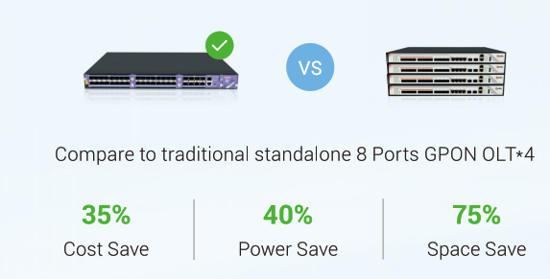
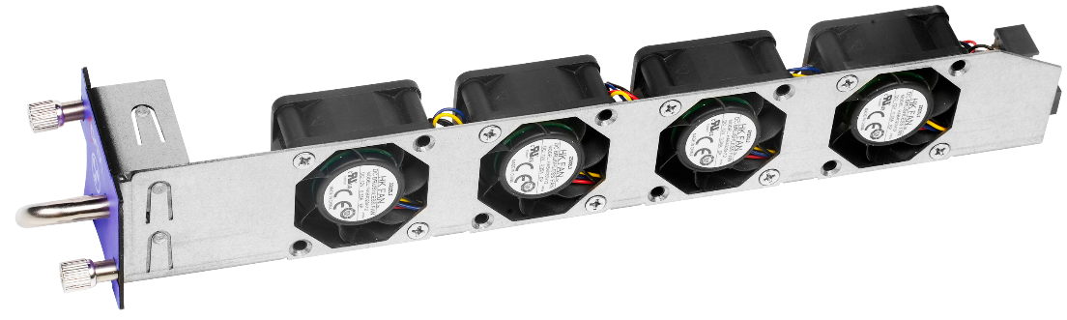
OLT - FD1700S 32 PON Ports

Slide 27

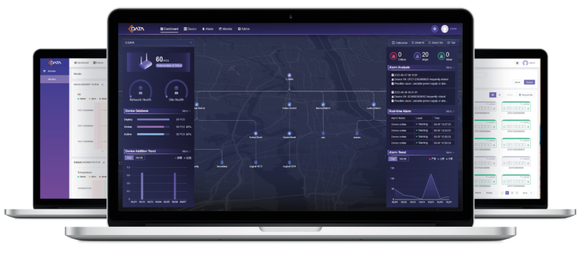
CMS – Sistema de Gestión
Descripción general de la plataforma
EMS/ACS integrado
Implementación local y en la nube
Admite todos los productos de C-Data
Características
Administre ONU directamente basado en TR069
Evite problemas de compatibilidad a través de la OLT de terceros
Administrar OLT a través de SNMP/MQTT
100,000 devices maximum
Network Status Analysis

Slide 28
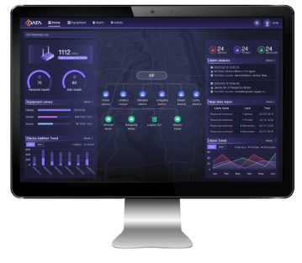
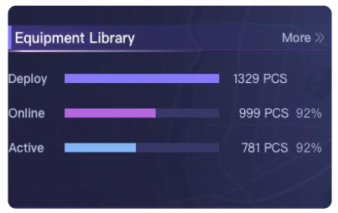
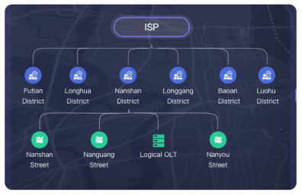
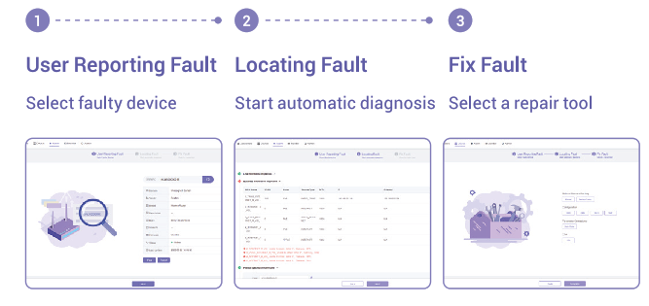
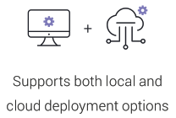
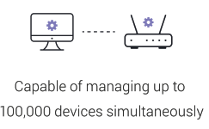
CMS – Sistema de Gestión

Slide 29



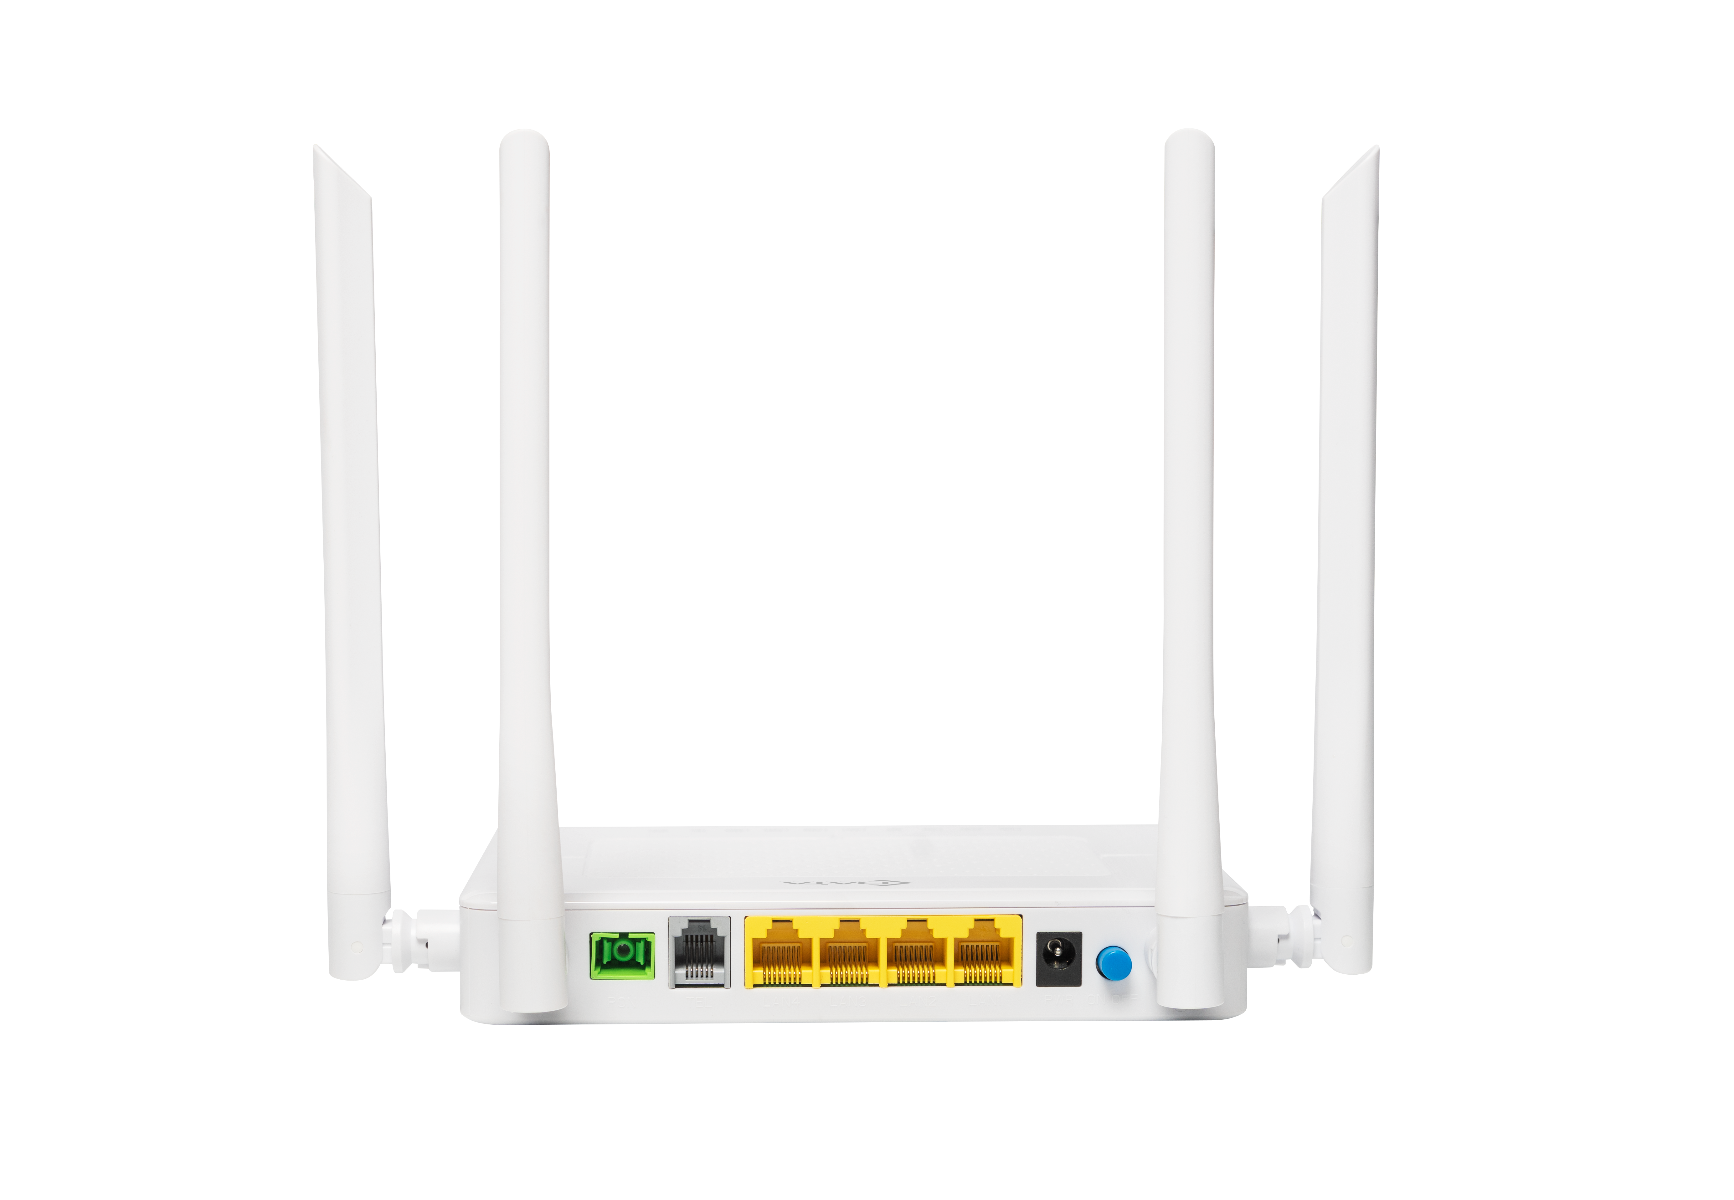
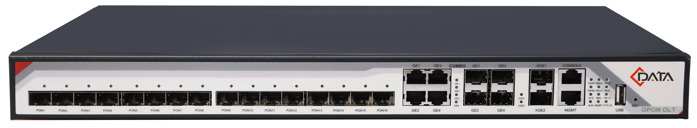
CMS – Sistema de Gestión
Single ISP :
Reseller :
Apply for On-Premise or SaaS deployment
Bind ONU/OLT devices
Apply for On-Premise or SaaS deployment
Create multiple ISPs
Each ISP independently binds ONU/OLT devices
ISP
Reseller
2
Create ISP A
2
Create ISP B
1
Deploy
1
Deploy
On-Premise / SaaS
CMS Server
On-Premise / SaaS
CMS Server
2
Bind
ISP A
3
Bind
ISP B

Slide 30



CMS – Sistema de Gestión
Provide software value-added services to enhance product competitiveness and increase user stickiness
Timely check the activation quantity of operator devices to assist in management decision-making
Improve device management efficiency of operators and reduce operation and maintenance costs
Reseller
ISPs
On-Premise：
Install and start CMS service
ISP A
login to CMS Web
Bind ONU/OLT devices
Login to CMS Web
Create ISPs
A and B
SaaS：
Obtain account from C-DATA
ISP B
login to CMS Web
Bind ONU/OLT devices

Slide 31



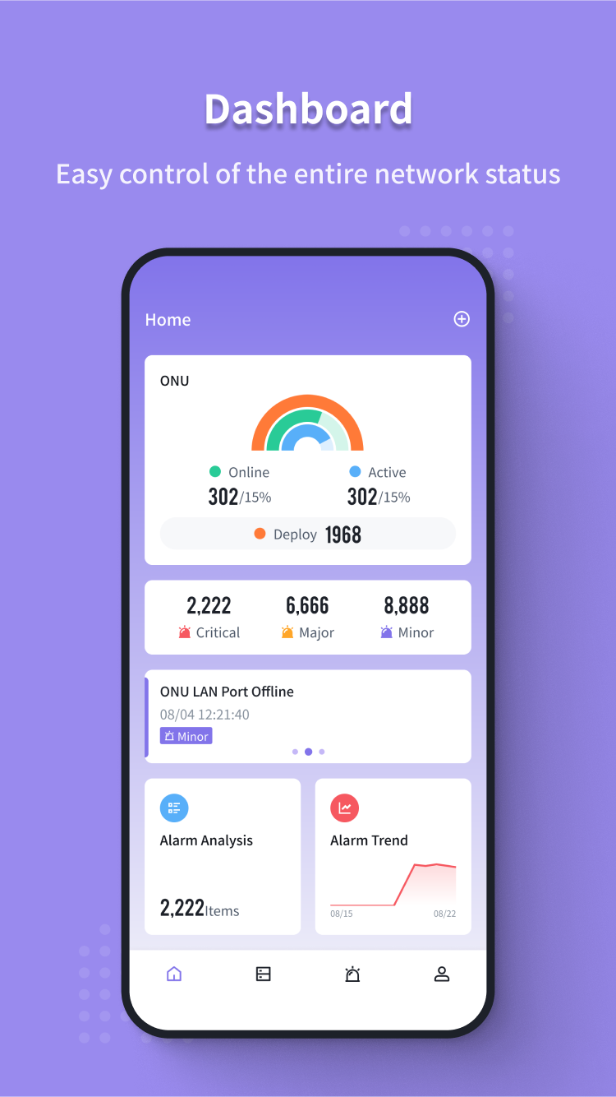
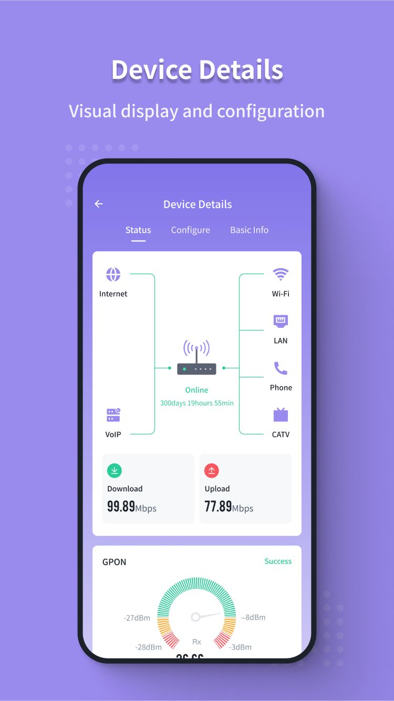
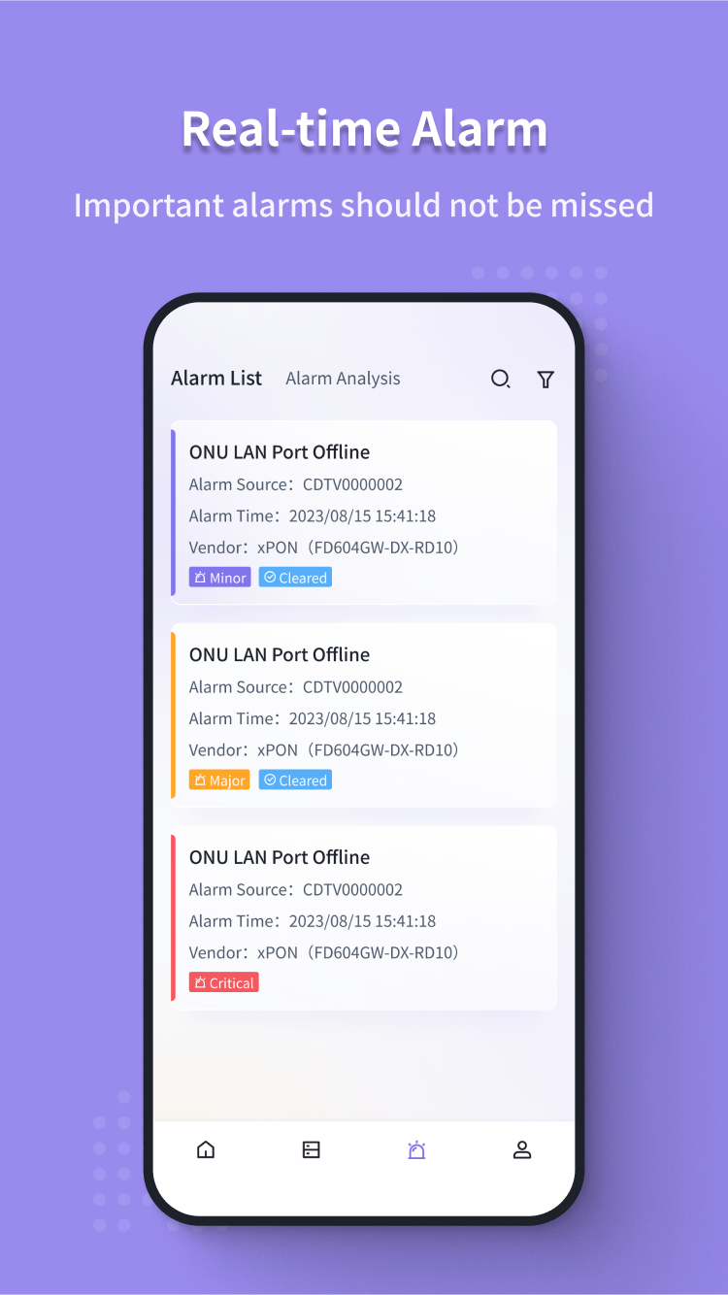

CMS APP: Anytime, any where, easy control
Intelligent data analysis
Device management and maintenance
Zero-touch activation
Provide dashboard , which calculates the online/offline ratio of device, trend of device and alarm additions, and intelligent analysis of alarms
Visual display and configuration the device
Support automated fault diagnosis processes
View real-time alarms/events
Provide clear process guidance for operation and installation personnel, bind ONU and CMS, and quickly open business for users.

Slide 32

Northbound Interface
CMS can provide abundant data such as Device List/Operation/Alarm/Performance through Restful API ;
CMS centralizes the processing of OLT and ONU data, replacing devices that directly provide data to improve system stability .
Third-party System
OSS/BSS
CRM
Billing
Monitoring
......
Northbound Interface
Restful API Management Service
CMS Service Layer
Device List
Operation
Alarm&Monitor
Performance
......
MQTT
TR-069
OMCI
OMCI

Slide 33


Connecting the World with Data Technology
Victor Manuel Martinez Cano
Product and Engineering Manager of C-Data México
Shenzhen C-Data Technology Co., Ltd.
https://www.cdatatec.com/

